Slide 1
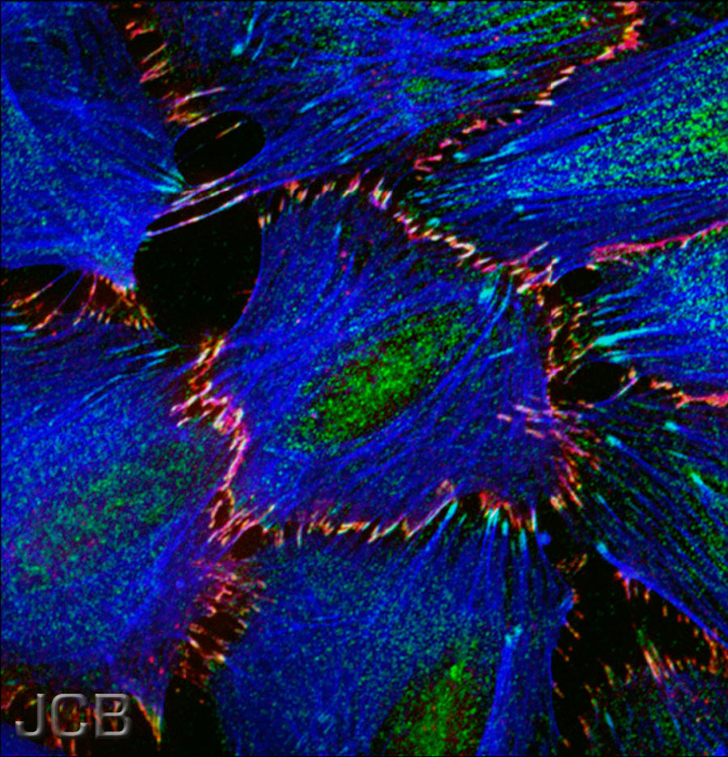
Principles and Practices of Light Microscopy II: Brightfield optics, resolution, and aberrations

Slide 2
Trans-illumination Microscope
Camera
Final image plane
Secondary pupil plane
Projection Eyepiece
Imaging
path
Intermediate image plane
Tube lens
Back focal plane (pupil)
Objective
Sample
Object plane
Condenser lens
The aperture iris
controls the range of
illumination angles
Aperture iris
(pupil plane)
Illumination
path
Field lens
Field iris
(image plane)
The field iris
controls the
illuminated
field of view
Collector
Light source
(pupil plane)

Slide 3
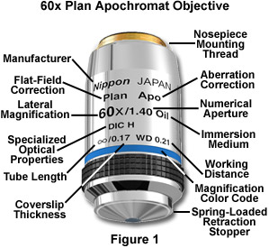
By far the most important part: the Objective Lens
Each major manufacturer sells 20-30 different categories of objectives.
What are the important distinctions?

Slide 4
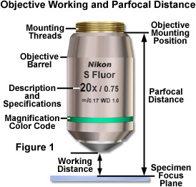
Working Distance
In general, high NA lenses have short working distances
However, extra-long working distance objectives do exist
Some examples:
10x/0.3 WD = 15.2mm
20x/0.75 WD = 1.0mm
100x/1.4 WD = 0.13mm

Slide 5
The focal length of a lens depends on the refractive index…
Refractive index n
Focal length f
f ∝ 1/(n-1)

Slide 6
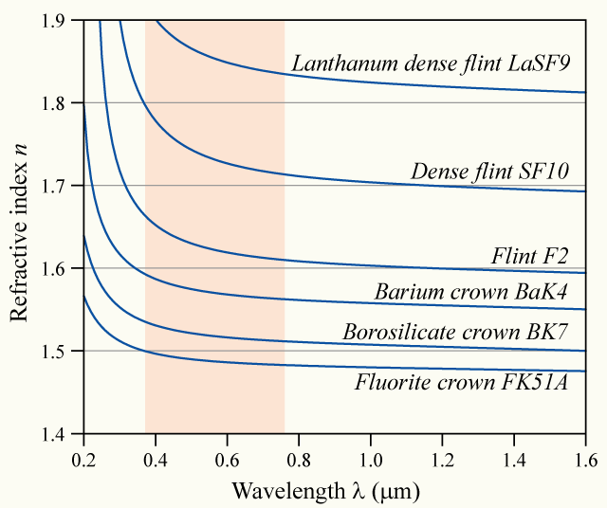
… and the refractive index depends on the wavelength (“dispersion”)
Glass
types

Slide 7
⇒ Chromatic aberration
Different colors get focused to different planes
Not good…

Slide 8
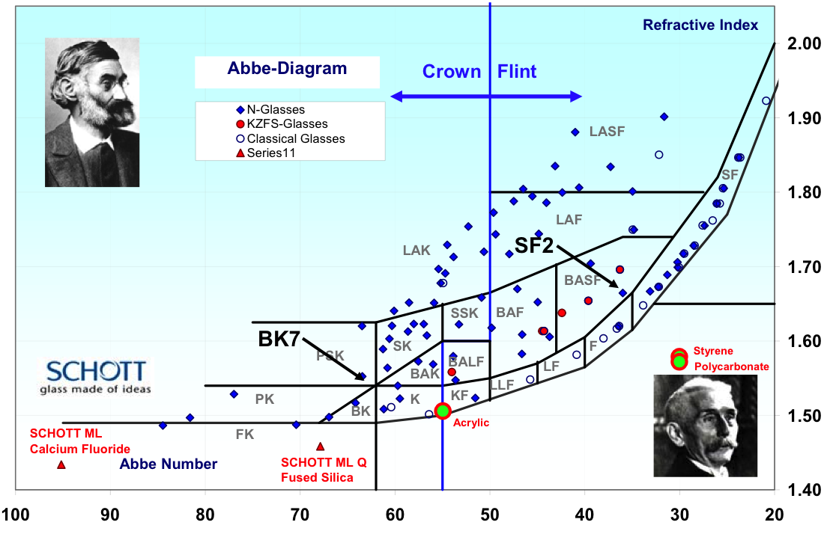

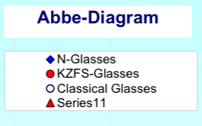

Dispersion vs. refractive index of different glass types
Refractive
index
Abbe dispersion number
(Higher dispersion→)

Slide 9
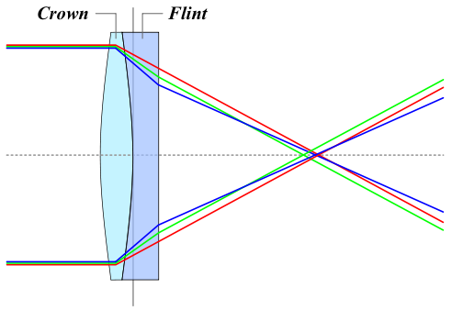
Achromatic Lenses
Use a weak negative flint glass element
to compensate the dispersion of a
positive crown glass element

Slide 10
Achromats and Apochromats
Focal length
Wavelength
Apochromat (≥3 glass types)
Achromat (2 glass types)
Simple lens

Slide 11
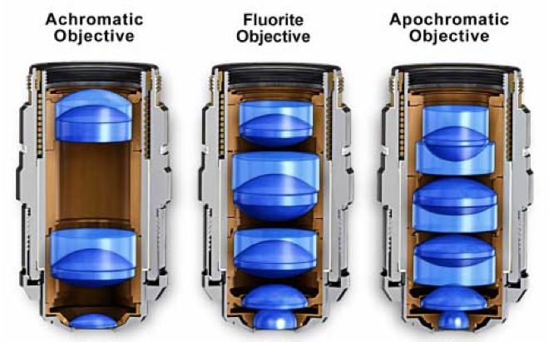
Correction classes of objectives
Achromat (cheap)
Fluor “semi-apo” (good correction, high UV transmission)
Apochromat (best correction)
Correction for other (i.e. monochromatic) aberrations also improves in the same order

Slide 12
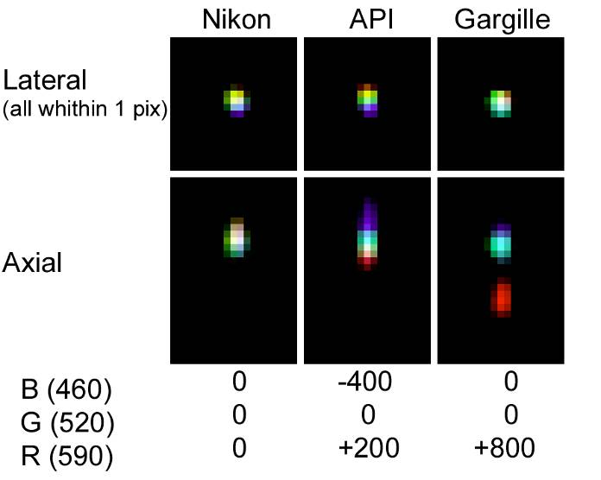
Using the wrong immersion oil can induce axial chromatic aberration
Cargille
(X-Y)
(X-Z)
Steve Ross
Notes:
All taken with TYPE A oil. 60x/1.40. Different dispersions. Lateral is an X-Y projection. Axial is 3D in Z. NF and DF oils have some auto fluorescence in visible but not near UV and UV. Use type A for visible fluorescence.

Slide 13
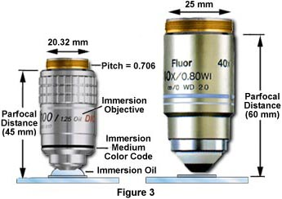
Putting one brand of objectives onto another brand of microscope?
Pitch = 0.75
Usually a bad idea:
May not even fit
May get different magnification than
is printed on the objective
Incompatible ways of
correcting lateral chromatic
aberration (LCA)
⇒ mixing brands can produce severe LCA
Tube lens focal length
Nikon 200
Leica 200
Olympus 180
Zeiss 165
LCA correction:
In objective In tube lens
Nikon Leica Olympus Zeiss

Slide 14
Lateral chromatic aberration (= LCA, lateral color, chromatic difference of magnification)
= Different magnification for different colors
Object
Image

Slide 15
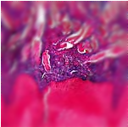
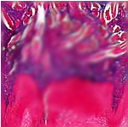
Curvature of Field
Focal plane
Focal plane Focal surface
Tube lens
objective
sample
Focal
surface

Slide 16
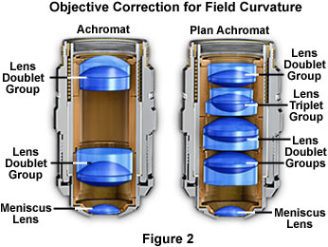
Plan objectives
Corrected for field curvature
More complex design
Needed for most photomicrography
Plan-Apochromats have the highest performance
(and highest complexity and price)

Slide 17
Aberrations
Chromatic aberrations
Longitudinal chr. Ab.
Lateral chr. Ab.
Curvature of field
Distortion
Wavefront aberrations
Spherical aberration
Astigmatism
Coma
…

Slide 18
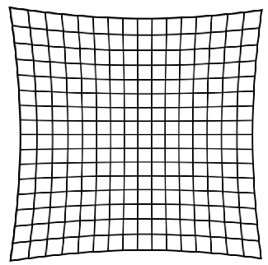
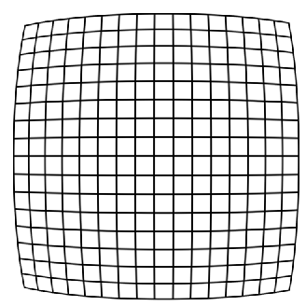
Geometric Distortion
= Radially varying magnification
Image
Object
Pincushion
distortion
Barrel
distortion
May be introduced by the projection eyepiece

Slide 19
Diffraction by an aperture
drawn as waves
Light spreads to new angles
Larger aperture
⇔
weaker diffraction

Slide 20
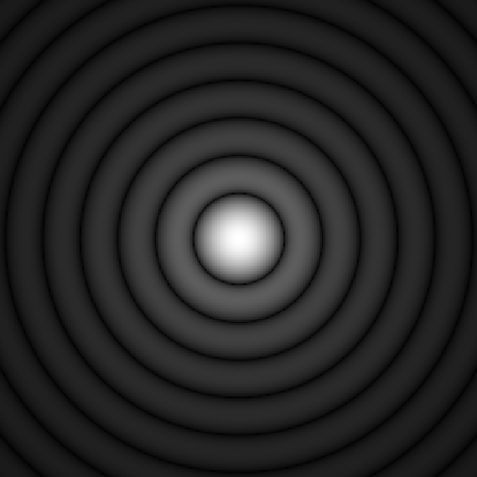
Diffraction by an aperture
drawn as rays
The pure, “far-field”
diffraction pattern
is formed at ∞ distance…
Tube lens
…or can be formed
at a finite distance
by a lens…
Intermediate
image
…as happens in a microscope
Objective pupil

Slide 21
The Airy Pattern
= the far-field diffraction pattern from a round aperture
Height of
first ring
≈ 1.75%
“Airy disk” diameter
d = 2.44 λ f/d
(for small angles d/f)
d
f

Slide 22
Aperture and Resolution
Diffraction spot
on image plane
= Point Spread Function
Intermediate image plane
Objective
Tube lens
Sample
Back focal plane aperture

Slide 23
Aperture and Resolution
Diffraction spot
on image plane
= Point Spread Function
Intermediate image plane
Objective
Tube lens
Sample
Back focal plane aperture

Slide 24
Aperture and Resolution
Diffraction spot
on image plane
= Point Spread Function
Intermediate image plane
Objective
Tube lens
Sample
Back focal plane aperture

Slide 25
Aperture and Resolution
Diffraction spot
on image plane
(resolution)
Intermediate image plane
Objective
Tube lens
Sample
α
Back focal plane aperture
Image resolution improves with aperture size
Numerical Aperture (NA)
NA = n sin(α)
= light gathering angle
n = refractive index of sample
where:

Slide 26

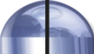
Numerical Aperture
100X / 0.95 NA
α = 71.8°
4X / 0.20 NA
α = 11.5°

Slide 27
Numerical Aperture
Compare:
Numerical Aperture:
NA = n sin(α)
Snell’s law:
n₁ sin(θ₁) = n₂ sin(θ₂)
θ₁
α
θ₂
n sin(θ) doesn’t change at horizontal interfaces
sin(anything) ≤ 1
NA cannot exceed
the lowest n between the
sample and the objective lens
Cover
glass
Sample

Slide 28
Numerical Aperture
Compare:
Numerical Aperture:
NA = n sin(α)
Snell’s law:
n₁ sin(θ₁) = n₂ sin(θ₂)
θ₁
α
θ₂
n sin(θ) doesn’t change at horizontal interfaces
sin(anything) ≤ 1
NA cannot exceed
the lowest n between the
sample and the objective lens
NA >1 requires fluid immersion
Immersion fluid
Cover
glass
Sample

Slide 29
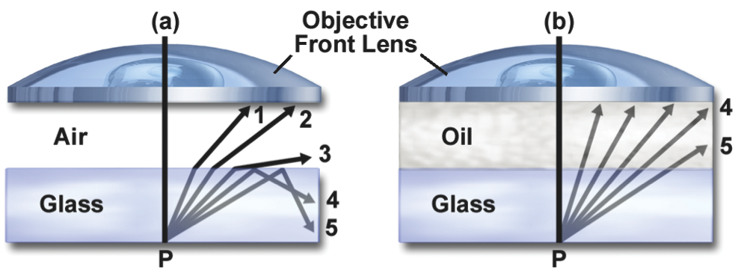
Immersion Objectives
NA cannot exceed
the lowest n between the
sample and the objective lens
NA >1 requires fluid immersion
Oil immersion:
n ≈ 1.515
max NA ≈ 1.4 (1.45–1.49 for TIRF)
Glycerol immersion:
n ≈ 1.45 (85%)
max NA ≈ 1.35 (Leica)
Water immersion:
n ≈ 1.33
max NA ≈ 1.2
NA can approach
the index of the
immersion fluid

Slide 30
Resolution
Ernst Abbe’s argument (1873)
Consider a striped sample ≈ a diffraction grating
Back focal
plane
Objective lens
β
Diffracted beams
d sin(β) = λ
Sample
Smaller d
→ larger β
d
Condenser
Light source
Consider first
a point light source
If β > α, only one spot makes it through
⇒ no interference ⇒ no image formed
Resolution (smallest resolvable d):
dmin = λsample/sin(α) = λ/n sin(α) = λ/NA

Slide 31
(Abbe’s argument, continued)
Now consider oblique illumination
(an off-axis source point):
One spot hopelessly lost,
but two spots get through
→ interference → image formed!
βout
d [sin(βin) + sin(βout) ] = λ
βin
Two spots get through if
βout < α and βin < α.
d
Resolution (smallest resolvable d)
with incoherent illumination (all possible illumination directions):
dmin = λ/(NAobj + NAcondenser )
λ/2 NA if NAcondenser ≥ NAobj (“Filling the back focal plane”)

Slide 32
Filling the back focal plane
In trans-illumination microscopy, to get maximum resolution,
the illumination must “fill the back focal plane”
Back
focal
plane
For the highest resolution,
we need to have
α_{condenser} ≥ α_{objective}
NA_{condenser} ≥ NA_{objective}
with oil immersion objectives,
we need an oil immersion condenser!
Objective
α_{objective}
α_{condenser}
Condenser
Light source

Slide 33
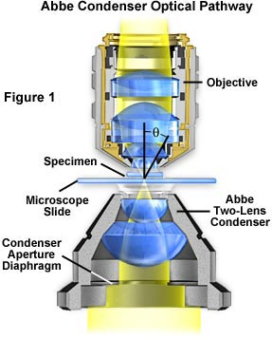
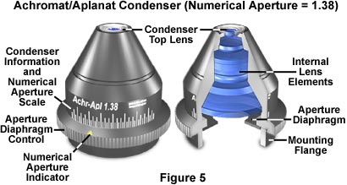
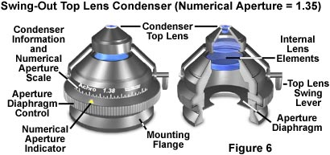
The Condenser
Tasks:
Illuminate at all angles < α_{objective}
Concentrate light on the field of view for all objectives to be used
Problem:
Low mag objectives have large FOV,
High mag objectives have large α
(With 2X and 100x objectives we need (100/2)² = 2500 times more light than any objective uses!)
Solutions:
Compromise
Exchangable condensers,
swing-out front lenses,…
Grade of correction
NA

Slide 34
Aperture, Resolution & Contrast
Can adjust the condenser NA with the aperture iris
Imaging
path
Intermed. image
Tube lens
Back aperture
Objective
Q: Don’t we always want
it full open??
A: No
Why? Tradeoff:
resolution vs. contrast
Sample
Condenser lens
Aperture iris
Field lens
Illumination
path
Field iris
Collector
Light source

Slide 35
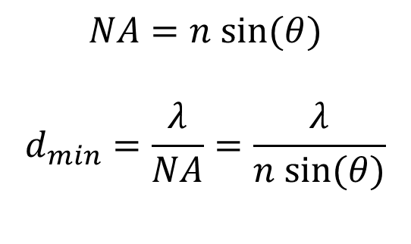
Numerical Aperture and Resolution
Snell’s law:
n₁ sin(θ₁) = n₂ sin(θ₂)
θ₁
Immersion
fluid
Cover
glass
θ₂
Sample
$$NA=n sin⁡(θ)$$
$$d_{min}=\frac{λ}{NA}=\frac{λ}{n sin⁡(θ)}$$

Slide 36
Numerical Aperture and Resolution
Sample, coverglass, immersion fluid, and top lens of objective all have same refractive index.
What happens if we change that refractive index?
Immersion
fluid
Cover
glass
Sample
$$NA=n sin⁡(θ)$$
$$d_{min}=\frac{λ}{NA}=\frac{λ}{n sin⁡(θ)}$$
Resolution improves with RI! Why?

Slide 37
Light travels more slowly in matter
And the wavelength shortens
n = 1
n > 1
n = 1
Recall Abbe’s experiment: dmin = λsample/sin(α) = λ/n sin(α) = λ/NA

Slide 38
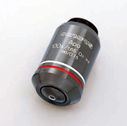
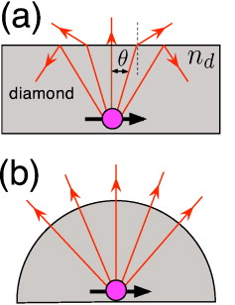
Modifying RI to change resolution
Olympus 1.65 NA TIRF lens: Uses sapphire coverslips (n=1.76), diiodomethane (n=1.74)
Diamond solid immersion lens
Appl. Phys. Lett. 97, 241902 (2010)

Slide 39
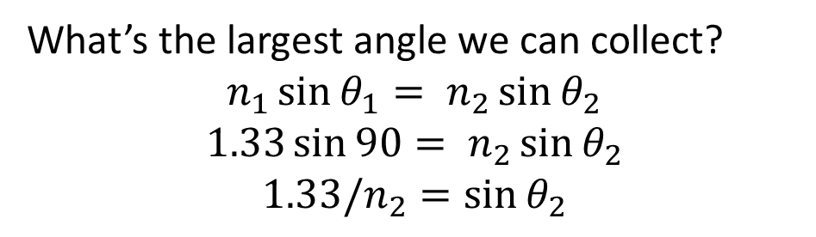
Why not use NA 1.65 lenses?
Glass n = 1.51
Sapphire n = 1.78
Water
n = 1.33
Water
n = 1.33
NA 1.4 oil immersion objective
NA 1.65 oil immersion objective
What’s the largest angle we can collect?
$$n_{1}\sin{θ_{1}}= n_{2}\sin{θ_{2}}$$
$$1.33\sin{90}= n_{2}\sin{θ_{2}}$$
$$1.33/n_{2}=\sin{θ_{2}}$$

Slide 40
Effective NA is limited by the sample
To use a high NA objective, need a high RI mounting medium
Water 1.33 Glycerol 1.45 Vectashield 1.44 Prolong Gold 1.39 – 1.46 2,2-thiodiethanol 1.52 Methyl Salicylate 1.53 Benzyl benzoate 1.57

Slide 41
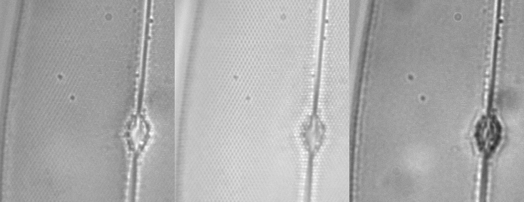
NA and Resolution
High NA Objective Low NA Objective

Slide 42
Alternate Definitions of Resolution
As the Full Width at Half Max
(FWHM) of the PSF
FWHM
≈ 0.353 λ /NA
As the diameter of the Airy disk
(first dark ring of the PSF)
= “Rayleigh criterion”
(Probably most common definition)
Airy disk radius
≈ 0.61 λ /NA

Slide 43
Objective Types
Field flatness
Plan or not
Phase rings for phase contrast
Positive or negative
Diameter of ring (number)
Special Properties
Strain free for Polarization or DIC
Features
Correction collar for spherical aberration
Iris
Spring-loaded front end
Lockable front end
Basic properties
Magnification
Numerical Aperture (NA)
Infinite or finite conjugate
Cover slip thickness if any
Immersion fluid if any
Correction class
Achromat
Fluor
Apochromat

Slide 44
Further reading
www.microscopyu.com
micro.magnet.fsu.edu
Michael W. Davidson and Douglas B. Murphy “Fundamentals of Light Microscopy and Electronic Imaging”
James Pawley, Ed. “Handbook of Biological Confocal Microscopy, 3rd ed.”
Acknowledgements
Ron Vale / Mats Gustafsson / Steve Ross

